Slide 1
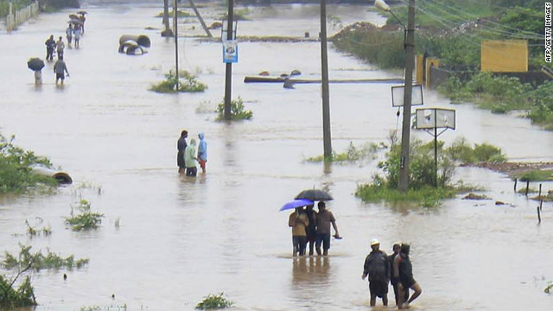
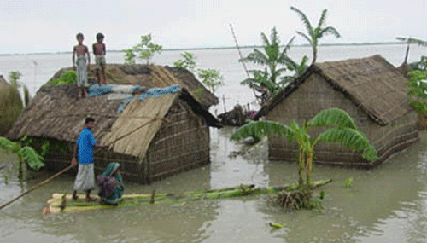
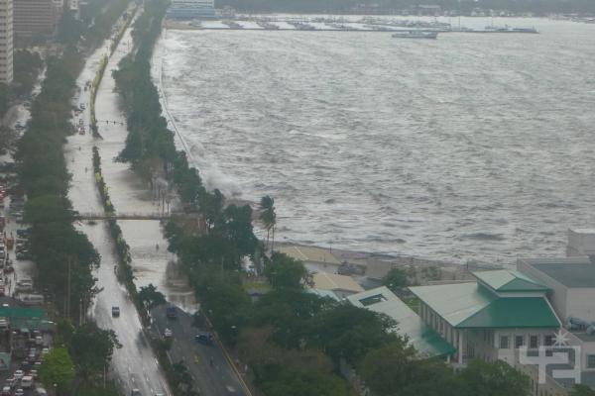
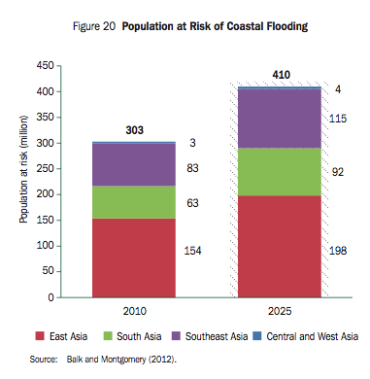
Synergized Standard Operating Procedures (SSOP) for Coastal Multi-hazards Early Warning System 41st PTC Session
Dhaka, Bangladesh
02-06 March 2014
Olavo Rasquinho – Sec. of Typhoon Committee
(On behalf of Mr James Weyman-
Project Manager/Technical Advisor of SSOP)

Slide 2
SSOP Project
Goal: To promote community resilience to coastal multi-hazards and to improve the policy and institutional arrangements at national, district, and community levels through integrated, effective standard operating procedures for multi-hazards early warning system
Focused mainly on the National Meteorological and Hydrological Services to meet the needs of diverse users
Funded by: ESCAP Trust Fund for Tsunami, Disaster and Climate Preparedness in Indian Ocean and Southeast Asian Countries
Time Frame: 29 months (1 August 2012 – 31 December 2014 (extension requested)

Slide 3
Beneficiary Countries
PTC region (7):
Bangladesh (Pilot); India; Maldives; Myanmar; Pakistan (Pilot); Sri Lanka; Thailand
TC region (7):
Cambodia; China; Lao PDR; Malaysia; Philippines (Pilot); Thailand and Viet Nam

Slide 4
Outcomes
Expected Outcome 1: Integrated, effective standard operating procedures for coastal multi-hazard EWS for TC and PTC Members
Support Activity 1: Review and synergize existing SOPs for coastal multi-hazards EWS and develop a Manual of Synergized SOPs for Coastal Multi-Hazards EWS
1.1 – Conduct workshop to collect and analyse performance status of coastal multi-hazard EWS and associated SOPs. (8-9 May 13)
1.2 – Conduct pilot missions and workshops to identify strengths, gaps, and needs of SOPs for EWS. (Completed)
1.3 – Synergize existing SOPs and develop additional ones as needed to meet identified gaps and needs and compile a Manual of Synergized SOPs for Coastal Multi-Hazards EWS (In process)

Slide 5
Outcomes
Expected Outcome 2: Improved performance and effectiveness of SOPs for coastal multi-hazard EWS through integration, synergization, cooperation, and training.
Support Activity 2: Enhance the performance and effectiveness of SOPs for coastal multi-hazard EWS through capacity building
2.1 – Conduct training of users and issuers in the interpretation and preparation of EWS products for decision-making, media, and communications both in a large group and with individual missions
2.2 – Conduct working meeting on building a cooperation mechanism between TC and PTC for coastal multi-hazard EWS information sharing and technical transferring

Slide 6
SSOP Project Output
Main Output 1: Manual of Synergized Standard Operating Procedures (SSOP) for Coastal Multi-Hazards Early Warning System, mainly focusing on hydro-meteorological service including SOPs related to warning providers, disaster managers, media, and fishermen.
Main Output 2: Regular communication and cooperation mechanism between TC and PTC on coastal multi-hazard early warning, particularly southern countries in the region.

Slide 7
Other Projects Under ESCAP Tsunami Trust Fund
Asian Disaster Preparedness Center (ADPC) in association with Global Alliance on Accessible Technologies for Environment (GAATES) Technical Assistance for enhancing the capacity of end-to-end multi-hazard EWS for coastal Hazards in Myanmar, Sri Lanka and Philippines
Asia-Pacific Broadcasting Union (ABU) Disaster Risk Reduction Broadcast Media Initiative
Regional Integrated Multi-Hazard Early Warning System (RIMES) in cooperation with World Meteorological Organization Reducing risks of tsunami, storm surges, large waves and other natural hazards in low elevation coastal zones

Slide 8
Partners
TC and PTC Country Focal Points (NMHS and NDMO)
ESCAP Economic and Social Commission of Asia and Pacific
TC Typhoon Committee
PTC Panel on Tropical Cyclones
ADPC Asian Disaster Preparedness Center
ABU Asia-Pacific Broadcasting Union
GAATES Global Alliance on Accessible Technologies for Environments
ADRC Asian Disaster Reduction Center
IOC Intergovernmental Oceanographic Commission of UNESCO
WMO World Meteorological Organization
RIMES Regional Integrated Multi-Hazard Early Warning System

Slide 9
Structure of SSOP Project
Steering Committee Composition
Chairperson of TC AWG, TC Secretary, and PTC Secretary
Duties
Select Consultant (s) and Project Manager
Provide guidance to Task Force, Project Manager and Consultant(s)
Monitor progress of the SSOP project implementation
Program Manager/Technical Advisor
Duties
Implement SSOP in accordance with planned schedule
Coordinate related programmes or activities
Prepare progress reports
Coordinate draft Manual of SSOP for Coastal Multi-Hazards EWS

Slide 10
Structure of SSOP Project (Cont.)
Task Force Structure and Organization
Chairpersons/representatives of WGM, WGH, WGDRR, TRCG of TC, Chairpersons/representatives of WGM, WGH, WGDRR of PTC/ Heads of RSMC
Representatives from TC and PTC Secretariats
Consultants from potential cooperation organizations
Focal points from 13 beneficiary countries among Members of TC and PTC (also from non beneficiary countries – Japan, Rep of Korea and Hong Kong, China)

Slide 11
Conclusions - May 8-9 2013 Initial Workshop
Manual of Synergized Standard Operating Procedures
Wide variety of cultures, governments, past experiences, relationships, risks, and people - SSOPs must be flexible best practices, operational guidelines and recommendations
Focused on meteorological and hydrological services, disaster management offices, and national tsunami warning centers. Other agencies must be involved in detailed, integrated ways to make end to end, cross-cutting EWS work. Various user sectors needs within government, businesses, and communities should be addressed.
Need for policy part of SOP development. With different agencies and government levels, policy framework required for success.

Slide 12
Conclusions - May 8-9 2013 Initial Workshop (Cont.)
Training and Human Capacity Building
Technical required, but also other types needed. Train warning preparer to communicate better with media and media to better understand risks and potential impacts.
Awareness of risks, potential, similarities and differences among coastal hazards at various levels needed
At community level, training on meaning of warnings, risk, potential, and actions needed. Methods needed to increase awareness especially for areas not significantly impacted for 10 -30 years.

Slide 13
Three In-Country Pilot Workshops
Team Members
Jim Weyman, Project Manager/Technical Advisor (Philippines and Bangladesh, Skype into Pakistan)
Olavo Rasquinho, Meteorological Expert, TCS
Atiq Kainan Ahmed, Disaster Response Expert, ADPC
Walter Welz, Media Expert, ABU (Philippines and Bangladesh)
Ahmed Said Al Barwani, Hydrology Expert, PTC (Oman)
Nadeem Ahmed, Media Expert, ABU (visited Pakistan)

Slide 14
Three In-Country Pilot Workshops (Cont.)
In Country Pilot Workshops were held:
October 3-4, 2013 Manila, Philippines
October 6-7, 2013 Dhaka, Bangladesh
October 10-11, 2013 Islamabad, Pakistan
Draft copies of detailed reports of pilot workshops, a summary report, and report of the May 8-9, 2013 kickoff meeting (and other related documents) at:
http://www.typhooncommittee.org/SSOP/indexSSOP.html

Slide 15
Purpose of Pilot Workshops
Sub-Activity 1.2: Conduct pilot missions and workshops focused on institutional capacity building from the national level to the local level and identification of pilot countries’ strengths, needs, and gaps in the area of EWS SOPs.
Workshop Purpose
Review existing SOPs for coastal multi-hazards EWS for hydro-meteorological, disaster management, media, elected official, and others from national to local levels
Identified strengths, gaps and needs in both agency internal SOPs and also integrated SOPs among agencies.
Develop an action plan

Slide 16
Conclusion Pilot Workshops - EWS
Recurring Themes of Required Items
High level government commitment and support
Legal and legislature framework.
Collaboration/coordination – national, regional, and local.
Media involvement as a partner.
Multi-hazard approach
Fully implemented elements of a people centered EWS
Technical and financial assistance to prepare required SOPs

Slide 17
Conclusion Pilot Workshops - SOPs
Strengths
Favorable framework for creation/maintaining SOPs.
Excellent examples of existing SOPs
Systems in detection, monitoring, forecasting, and warning services
System/situation in dissemination &communications
Systems in response and preparedness capacity
Supporting MOUs in place

Slide 18
Conclusion Pilot Workshops - SOPs
Gaps and Needs – SOPs for Specific Areas
Roles and responsibilities defined in national policies
SOPs for both technical and non-technical activities
Hydro-meteorological service SOPs on all aspects of forecast and warning process
SOP to cover back-up plans for catastrophic events such as power failure, fire, earthquake damage, etc.
SOP to prepare after action reports to release to media & public
Local government SOPs on evacuation, sheltering, and resettlement

Slide 19
Conclusion Pilot Workshops - SOPs
Gaps and Needs – Integrated, cross-cutting SOPs Needs
Multiagency SOP on dissemination process
Multiagency SOP on mechanism for sharing data/data analysis
Local communities SOPs to prevent conflicting activities
Coordination procedures on dissemination of warnings at all levels and agencies to prevent conflicting information
Coordinated procedures for implementing new/updated SOPs
Involvement of non-government private, professional, civil society, community organizations and families in SOPs
Reference manual for media to understand/communicate information

Slide 20
Conclusion Pilot Workshops - SOPs
SOP testing and maintaining needs
Annual or scheduled reviews of all SOPs
Updated based on past experience and changes
Conduct post disaster assessment between DRR and media
MOU related needs
National plan/MOU clearly defining roles and responsibilities
DRR and media MOU to define single, official source of data
Hydro-meteorological service & media MOU on dissemination
Hydro-meteorological service and DRR MOU
MOU on data formats, warnings, and monitoring systems

Slide 21
Conclusion Pilot Workshops - Manual
Manual/Handbook should contain:
Minimum baseline standard & guidelines on format and content
Checklist for SOPs for different types/levels of threat
Guidelines for multi-hazards SOPs
Need for regular updating after a disaster
Need to conduct regular exercises/drills to validate SOPs
SOP examples from other countries
List of relevant available websites, case studies, documents, etc.
Examples of social media use for information dissemination
Need to incorporate designation of spokesperson for event

Slide 22
Compilation of EWS and SOP Guidance and Checklist
Prepared prior to In-Country Pilot Workshops to demonstrate information available and necessary for the Manual
Compilation - A Guide to Writing Effective SOPs
Compilation - Checklist for Effective SOPs for EWS
Compilation - Information on Early Warning System Overview
Compilation - Early Warning System Checklist Items
Compilation - General Basic Information on EWS for NHMS, Warnings, Communications, and Relationships
Based upon many different documents including ones from the Shanghai Meteorological Service and WMO

Slide 23
Future Plans and Activities
Activity 1.3
Prior activities been focused on involvement of pilot countries; focus shifts to broader involvement
Three prong approach:
  Missions/consultants to three pilot countries to obtain specific SOPs in use and to refine needs and gaps
  Missions/consultants to 6 other beneficiary countries to get specific SOP examples and inputs on needed ones. Focal points involvement.
  Program Manager, SSOP Task Force, TCS, and PTC begin compiling manual on SSOPs based on information collected in pilot workshops and two items above

Slide 24
Future Plans and Activities
Activity 2.1
Training session for 50 decision-makers, disaster managers, media professionals, and warning issuers from 13 target countries - possibly the second week of June 2014. Experts in meteorology, hydrology, DRR, media, social science, plus Program Manager, TCS and PTC representatives will assist “Train the Trainer” Concept
Missions to approximately 6 selected targeted countries to provide technical and financial assistance to assist initial develop, update, coordinate, and implement improved SOPs (need identified in pilot workshops)

Slide 25
Future Plans and Activities
Activity 2.2
Conduct working meeting for approximately 20 participants from target countries on building cooperation mechanism between TC and PTC for coastal multi-hazard EWS and SOPs information sharing and technical transferring. (Most likely in September – October 2014)
TC and PTC members’ focal points for a joint cooperative mechanism involved
Analyze current actions of the TC and PTC and how these can be used along with additional developed ones to create a sustainable cooperative mechanism between TC and PTC

Slide 26
Future Plans and Activities
Monitoring, Evaluation, and Audit
Scheduled for October – December 2014
Independent end of term evaluation commissioned by Typhoon Committee Secretariat in consultation with partners and ESCAP – Purpose: To facilitate learning
TCS will commission independent audit of the project funds at end of project and will submit to ESCAP

Slide 27
Resolutions of TC46 on SSOP
Approve the submission of no cost extension request to ESCAP for the SSOP project until 31 December 2014, instead 31 July 2014;
Encourage Members, in particular the SSOP beneficiary countries to collaborate with the SSOP project.
Encourage Members continuing cooperation on SSOP in 2014 assisting the manual drafting and training workshop;
Approve the organization of a SOP workshop in the WMO RTC Nanjing.

Slide 28
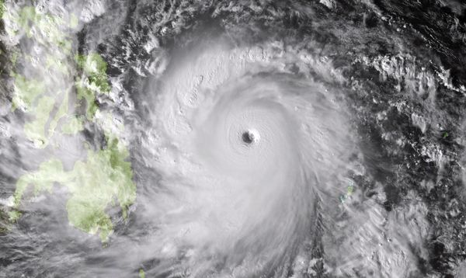
Thank you

